Slide 1
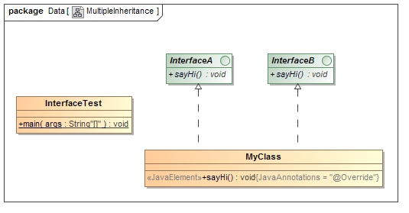
Multiple inheritance is not supported through class in java but it is possible by interface, why?
Multiple inheritance is not supported in case of class. But it is supported in case of interface ,because there is no ambiguity as implementation is provided by the implementation class.
As you can see in the below example, InterfaceA and InterfaceB have same methods(sayHi()) but its implementation is provided by class MyClass, so there is no ambiguity.

